Slide 1
Unit 202: Principles of electrical science
Resistivity

Slide 2
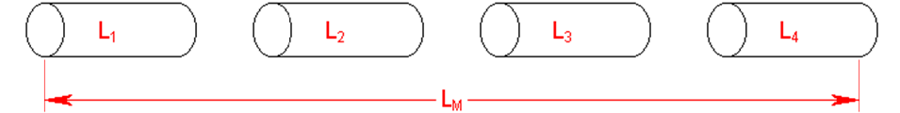
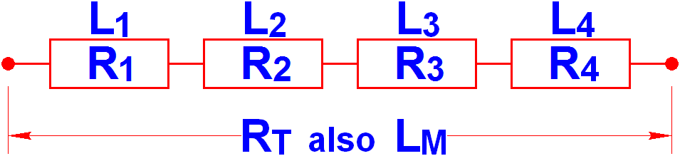
Resistance – length of conductor
L_{M} = L₁ + L₂ + L₃ + L₄
R_{T} = R₁ + R₂ + R₃ + R₄
R | ∝ | L

Slide 3
Resistance – length of conductor
EXAMPLE 1. If a cable has a resistance of 0.15Ω/m what will be the resistance of 320m of the same cable?
Since resistance is proportional length:
Resistance | = | Ω/m × length
 | = | 0.15 × 320
 | = | 48Ω

Slide 4
Resistance – length of conductor
EXAMPLE 2. If 50m of a conductor have a resistance of 0.01Ω what would be the resistance of 500m of the same cable?
Since resistance is proportional length:
Resistance | = | new length × resistance old length
Resistance | = | 500 × 0.01 50
 | = | 0.1Ω

Slide 5
Resistance – length of conductor
EXAMPLE 3. If 750m of a conductor have a resistance of 0.013Ω what will be the resistance of 150m of the same conductor?
Since resistance is proportional length:
Resistance | = | new length × resistance old length
Resistance | = | 150 × 0.013 750
 | = | 0.0026Ω

Slide 6
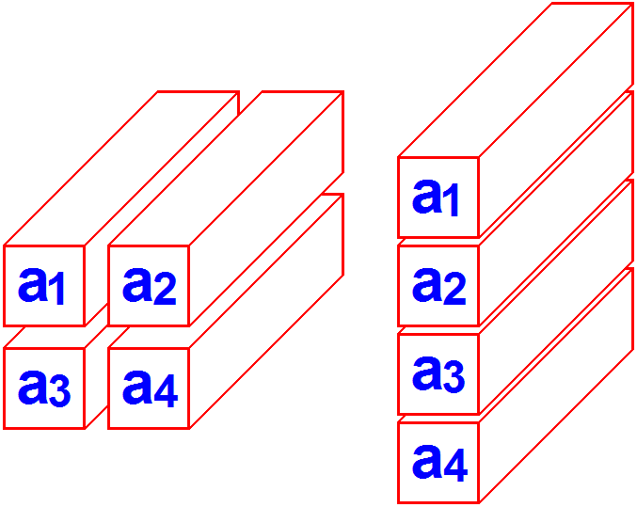
Resistance – cross sectional area of conductor
a_{T} = a₁ + a₂ + a₃ + a₄
 | 1 | = | 1 | + | 1 | + | 1 | + | 1
 | R_{T} |  | R₁ |  | R₂ |  | R₃ |  | R₄
R | ∝ | 1 a
Resistance is inversely proportional to area

Slide 7
Resistance – cross sectional area of conductor
EXAMPLE 4. If the resistance of 100m of a certain conductor is 0.076Ω, calculate the resistance of 100m of the same conductor but with:
a) twice the CSA
b) four times the CSA
c) half the CSA
d) one quarter of the CSA.
a) Since R is ∝ to 1/a, then:
R | = | 0.076 ÷ 2
 | = | 0.038Ω

Slide 8
Resistance – cross sectional area of conductor
b) Since R is ∝ to 1/a, then:
R | = | 0.076 ÷ 4
 | = | 0.019Ω
c) Since R is ∝ to 1/a, then:
R | = | 0.076 ÷ 1/2
 | = | 0.152Ω
d) Since R is ∝ to 1/a, then:
R | = | 0.076 ÷ 1/4
 | = | 0.304Ω

Slide 9
Resistance – cross sectional area of conductor
EXAMPLE 5. If the resistance of 100m of a certain conductor is 1.24Ω, calculate the resistance of 500m of the same conductor but with twice the CSA.
Resistance | = | new length × resistance old length
Resistance | = | 500 × 1.24 100
 | = | 6.2Ω
But:
R | ∝ | 1 a | (therefore the resistance must be halved)
R | = | 6.2 2
 | = | 3.1Ω

Slide 10
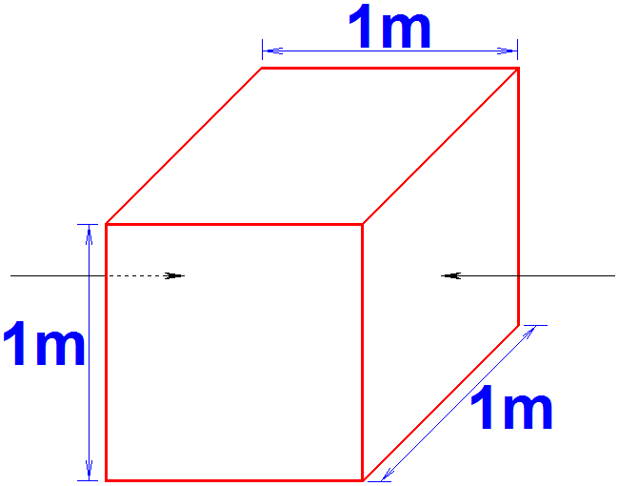
Resistivity – type of conducting material
Material | Resistivity at 20°C
Copper | 17.2 × 10⁻⁹ ohm metre
Aluminium | 26.5 × 10⁻⁹ ohm metre
Silver | 15.9 × 10⁻⁹ ohm metre
Gold | 22.4 × 10⁻⁹ ohm metre
Brass (58% copper) | 59.0 × 10⁻⁹ ohm metre
Brass (63% copper) | 71.0 × 10⁻⁹ ohm metre

Slide 11


Resistivity
or
Where:
R = conductor resistance in ohms
ρ = cable resistivity in Ω m
L = cable length in metres
a = cross sectional area (CSA) in metre².

Slide 12
Resistivity – cross sectional area of conductor
EXAMPLE 6. Calculate the resistance of 1,000m of 16mm² (CSA) single copper conductor. Take ρ to be 17.2 x 10⁻⁹ Ω metre.

Slide 13

Resistivity – cross sectional area of conductor
EXAMPLE 6. Calculate the resistance of 1,000m of 16mm² (CSA) single copper conductor. Take ρ to be 17.2 x 10⁻⁹ Ω metre.
 | = | 17.2 × 10⁻⁹ × | 1,000
 |  |  | 16 x 10⁻⁶
 | = | 1.075Ω

Slide 14
Resistivity – cross sectional area of conductor
EXAMPLE 7. Calculate the resistance of an aluminium wire 100m long and CSA of 25mm². Take the resistivity of aluminium to be 26.5 x 10⁻⁹ Ω metre.

Slide 15
Resistivity – cross sectional area of conductor
EXAMPLE 7. Calculate the resistance of an aluminium wire 100m long and CSA of 25mm². Take the resistivity of aluminium to be 26.5 x 10⁻⁹ Ω metre.
R | = | ρ x | L
 |  |  | a
 | = | 26.5 x 10⁻⁹ x | 100
 |  |  | 25 x 10⁻⁶
 | = | 0.106Ω

Slide 16
Resistivity – cross sectional area of conductor
EXAMPLE 8. Calculate the resistance of 100m of copper conductor if ρ = 17.2 x 10⁻⁹ Ω metre for the material and the CSA is 2.5mm².

Slide 17
Resistivity – cross sectional area of conductor
EXAMPLE 8. Calculate the resistance of 100m of copper conductor if ρ = 17.2 x 10⁻⁹ Ω metre for the material and the CSA is 2.5mm².
R | = | ρ x | l
 |  |  | a
 | = | 17.2 x 10⁻⁹ x | 100
 |  |  | 2.5 x 10⁻⁶
 | = | 0.688Ω

Slide 18
Resistivity – cross sectional area of conductor
EXAMPLE 9. Calculate the resistance of 100m of silver conductor if ρ = 15.9 x 10⁻⁹ Ω metre for the material and the CSA is 2.5mm².

Slide 19
Resistivity – cross sectional area of conductor
EXAMPLE 9. Calculate the resistance of 100m of silver conductor if ρ = 15.9 x 10⁻⁹ Ω metre for the material and the CSA is 2.5mm².
R | = | ρ x | l
 |  |  | a
 | = | 15.9 x 10⁻⁹ x | 100
 |  |  | 2.5 x 10⁻⁶
 | = | 0.636Ω

Slide 20
Voltage drop
As we have demonstrated in this lesson, the conductors themselves will have resistance and, like any resistance will affect the current flow and voltage drop in the circuit. The magnitude of the volt drop will not only depend on the resistance of the cable but also the amount of current being drawn by the load.

Slide 21
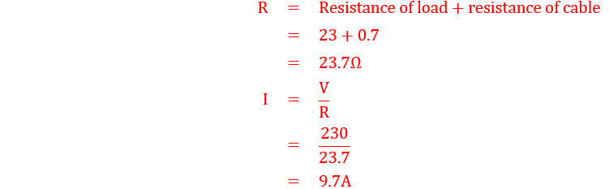
Voltage drop
Example 10
A load with a resistance of 23Ω is connected to 230V supply with a cable that has a total resistance of 0.7Ω. Calculate:
The voltage drop in the cable,
The voltage that will appear across the load.

Slide 22
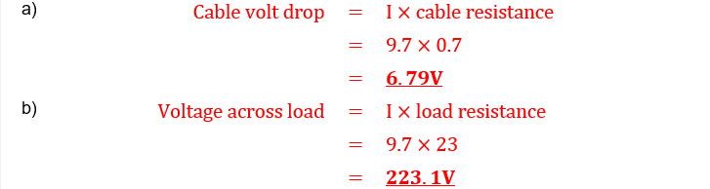
Voltage drop
Example 10
A load with a resistance of 23Ω is connected to 230V supply with a cable that has a total resistance of 0.7Ω. Calculate:
The voltage drop in the cable,
The voltage that will appear across the load.

Slide 23
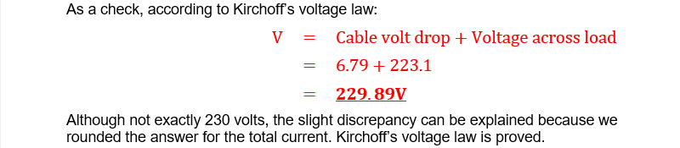
Voltage drop
Example 10
A load with a resistance of 23Ω is connected to 230V supply with a cable that has a total resistance of 0.7Ω. Calculate:
The voltage drop in the cable,
The voltage that will appear across the load.

Slide 24
Unit 202: Principles of electrical science
The End

